Slide 1
Knowledge Representation

Slide 2
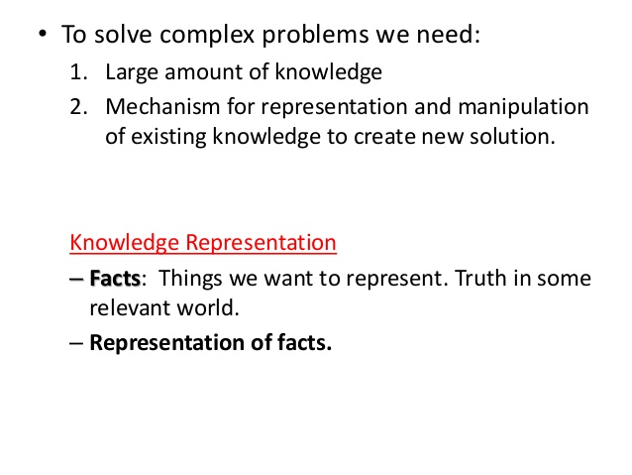

Slide 3
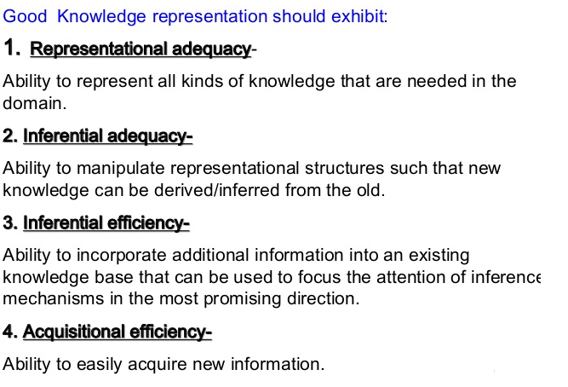

Slide 4
What is knowledge representation?
Humans are best at understanding, reasoning, and interpreting knowledge.
Human knows things, which is knowledge and as per their knowledge they perform various actions in the real world.
But how machines do all these things comes under knowledge representation and reasoning.
Hence we can describe Knowledge representation as following:
It is responsible for representing information about the real world so that a computer can understand and can utilize this knowledge to solve the complex real world problems such as diagnosis a medical condition or communicating with humans in natural language.
It is also a way which describes how we can represent knowledge in artificial intelligence.
Knowledge representation is not just storing data into some database, but it also enables an intelligent machine to learn from that knowledge and experiences so that it can behave intelligently like a human.

Slide 5
Propositional logic in Artificial intelligence
Propositional logic (PL) is the simplest form of logic where all the statements are made by propositions.
A proposition is a declarative statement which is either true or false.
It is a technique of knowledge representation in logical and mathematical form.
Example:
a) It is Sunday.
b) The Sun rises from West (False proposition)
c) 3+3= 7(False proposition)
d) 5 is a prime number.

Slide 6
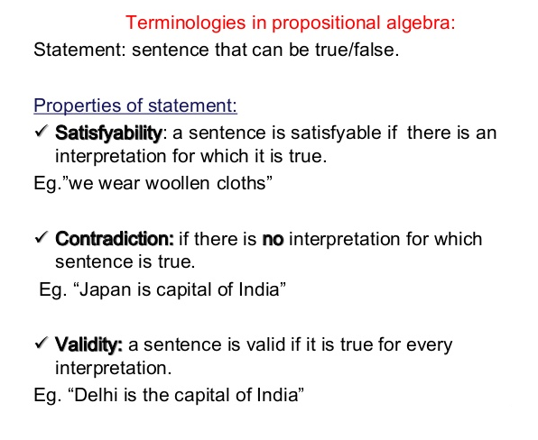
Basic facts about propositional logic:
Propositional logic is also called Boolean logic as it works on 0 and 1.
In propositional logic, we use symbolic variables to represent the logic, and we can use any symbol for a representing a proposition, such A, B, C, P, Q, R, etc.
Propositions can be either true or false, but it cannot be both.
Propositional logic consists of an object, relations or function, and logical connectives.
These connectives are also called logical operators.
The propositions and connectives are the basic elements of the propositional logic.

Slide 7
Logical Connectives:
Logical connectives are used to connect two simpler propositions or representing a sentence logically.
There are mainly five connectives, which are given as follows:
Negation: A sentence such as ¬ P is called negation of P. A literal can be either Positive literal or negative literal.
Conjunction: A sentence which has ∧ connective such as, P ∧ Q is called a conjunction. Example: Rohan is intelligent and hardworking. It can be written as, P= Rohan is intelligent, Q= Rohan is hardworking. → P∧ Q.
Disjunction: A sentence which has ∨ connective, such as P ∨ Q. is called disjunction, where P and Q are the propositions. Example: "Ritika is a doctor or Engineer", Here P= Ritika is Doctor. Q= Ritika is Doctor, so we can write it as P ∨ Q.
Implication: A sentence such as P → Q, is called an implication. Implications are also known as if-then rules. It can be represented as If it is raining, then the street is wet. Let P= It is raining, and Q= Street is wet, so it is represented as P → Q
Biconditional: A sentence such as P⇔ Q is a Biconditional sentence, example If I am breathing, then I am alive P= I am breathing, Q= I am alive, it can be represented as P ⇔ Q.

Slide 8
Limitations of Propositional logic:
We cannot represent relations like ALL, some, or none with propositional logic. Example:
All the girls are intelligent.
Some apples are sweet.
Sachin likes cricket.
Propositional logic has limited expressive power.
In propositional logic, we cannot describe statements in terms of their properties or logical relationships.
To represent the above statements, PL logic is not sufficient, so we required some more powerful logic, such as Predicate logic (first-order logic).

Slide 9
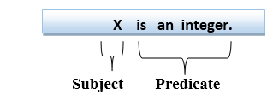
Knowledge representation Predicate logic
It is an extension to propositional logic.
FOL is sufficiently expressive to represent the natural language statements in a concise way.
First-order logic is also known as Predicate logic or First-order predicate logic.
First-order logic is a powerful language that develops information about the objects in a more easy way and can also express the relationship between those objects.
First-order logic statements can be divided into two parts:
Subject: Subject is the main part of the statement.
Predicate: A predicate can be defined as a relation, which binds two atoms together in a statement.
Consider the statement: "x is an integer.",
It consists of two parts, the first part x is the subject of the statement and second part "is an integer," is known as a predicate.

Slide 10
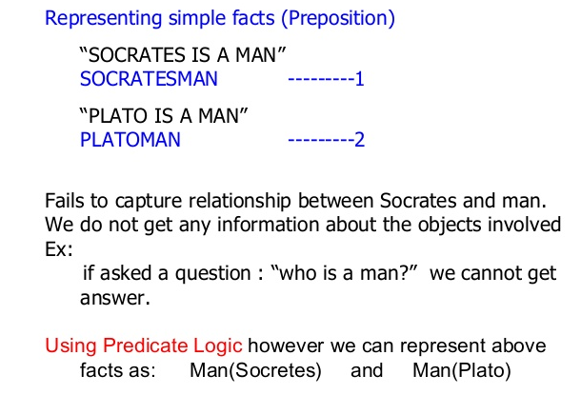
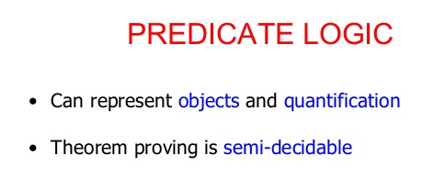

Slide 11
Quantifiers in Predicate logic:
A quantifier is a language element which generates quantification, and quantification specifies the quantity of specimen in the universe of discourse.
These are the symbols that permit to determine or identify the range and scope of the variable in the logical expression. There are two types of quantifier:
Universal Quantifier, (for all, everyone, everything)
Existential quantifier, (for some, at least one).
Example:
All man drink coffee. ∀x man(x) → drink (x, coffee)
It will be read as: There are all x where x is a man who drink coffee.
Some boys are intelligent. ∃x: boys(x) ∧ intelligent(x)
It will be read as: There are some x where x is a boy who is intelligent.
Notes: 1. The main connective for universal quantifier ∀ is implication →.
2. The main connective for existential quantifier ∃ is and ∧.

Slide 12
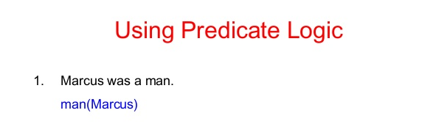

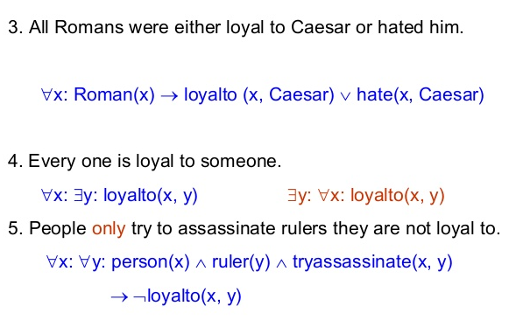
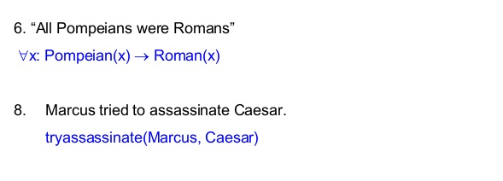

Slide 13
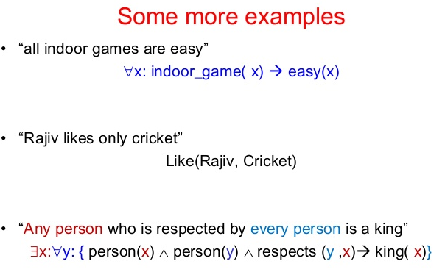
Examples of FOL using quantifier:
All birds fly. ∀x bird(x) →fly(x).
Every man respects his parent. ∀x man(x) → respects (x, parent).
Some boys play cricket. Here, the predicate is "play(x, y)," where x= boys, and y= game. Since there are some boys so we will use ∃, and it will be represented as: ∃x boys(x) → play(x, cricket).

Slide 14
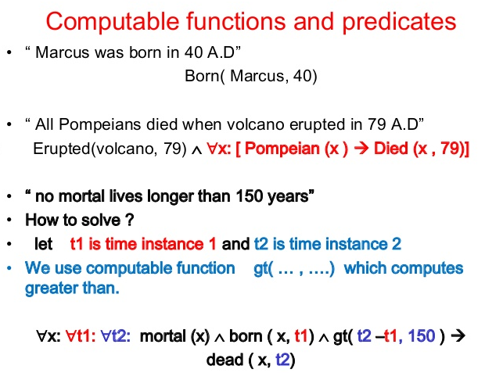

Slide 15
Isa and instance relationships
Two attributes isa and instance play an important role in many aspects of knowledge representation.
The reason for this is that they support property inheritance.
isa-- used to show class inclusion, e.g. isa(mega_star,rich).
instance-- used to show class membership, e.g. instance(prince,mega_star).
From the above it should be simple to see how to represent these in predicate logic.

Slide 16
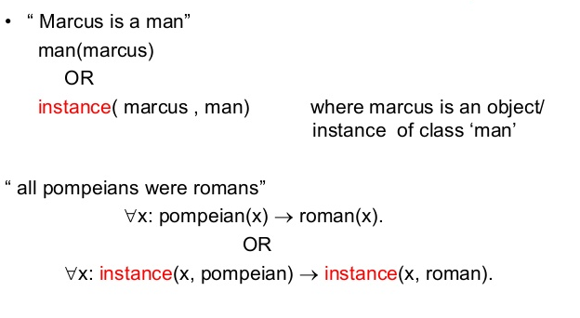
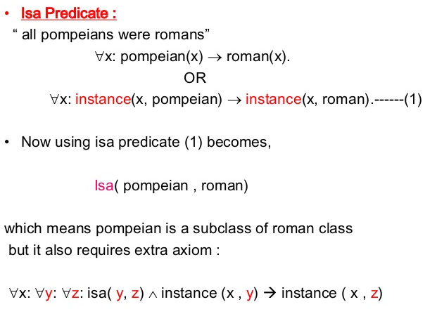

Slide 17
Resolution
Resolution is a theorem proving technique that proceeds by building refutation proofs, i.e., proofs by contradictions. It was invented by a Mathematician John Alan Robinson in the year 1965.
Resolution is used, if there are various statements are given, and we need to prove a conclusion of those statements.
Unification is a key concept in proofs by resolutions. Resolution is a single inference rule which can efficiently operate on the conjunctive normal form or clausal form.
Clause: Disjunction of literals (an atomic sentence) is called a clause. It is also known as a unit clause.
Conjunctive Normal Form: A sentence represented as a conjunction of clauses is said to be conjunctive normal form or CNF.

Slide 18
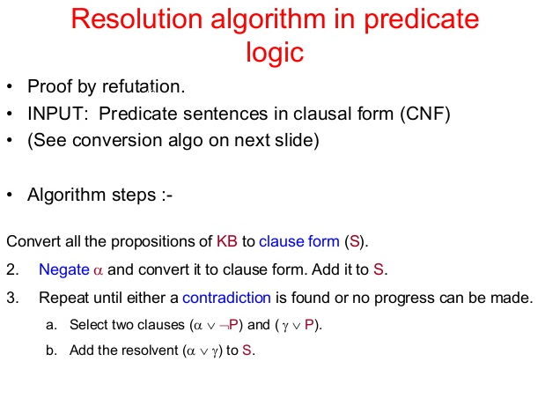

Slide 19
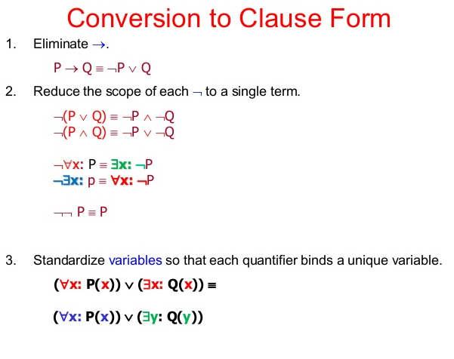

Slide 20
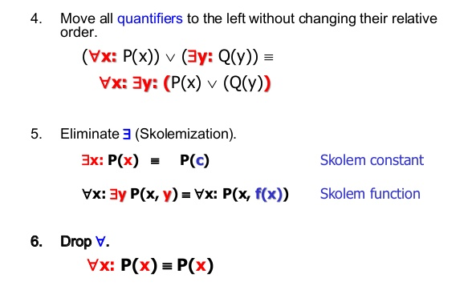
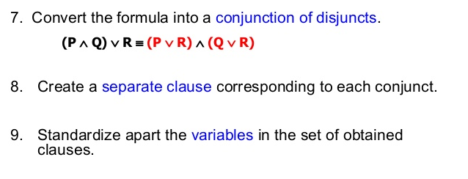

Slide 21
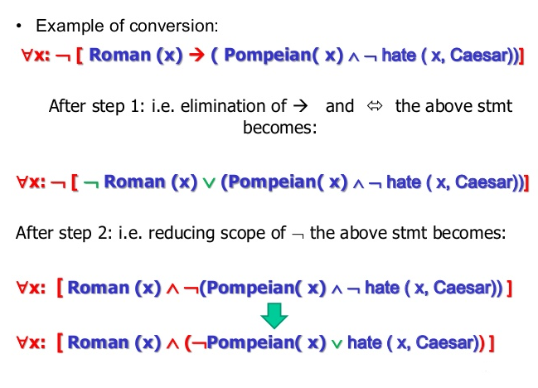

Slide 22
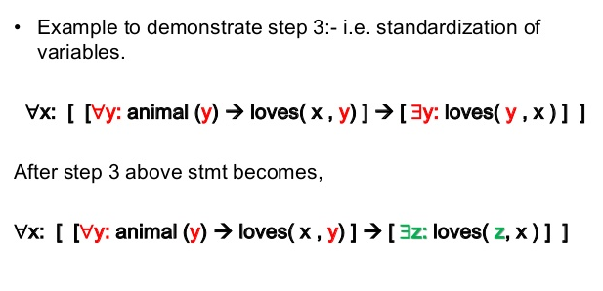
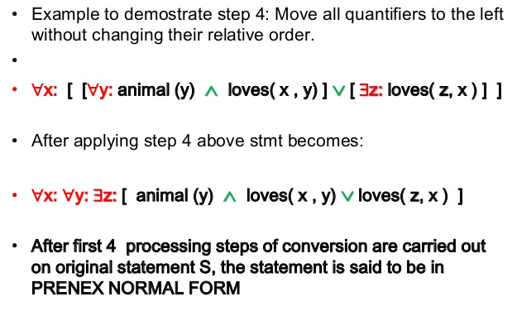

Slide 23
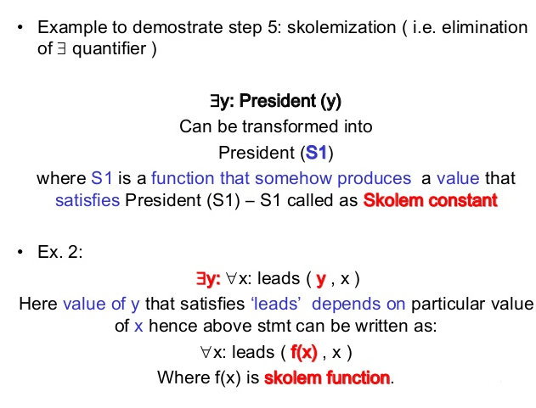
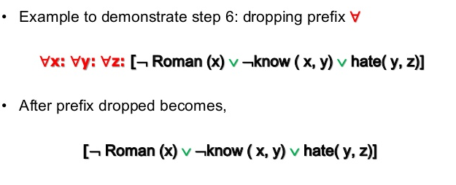

Slide 24
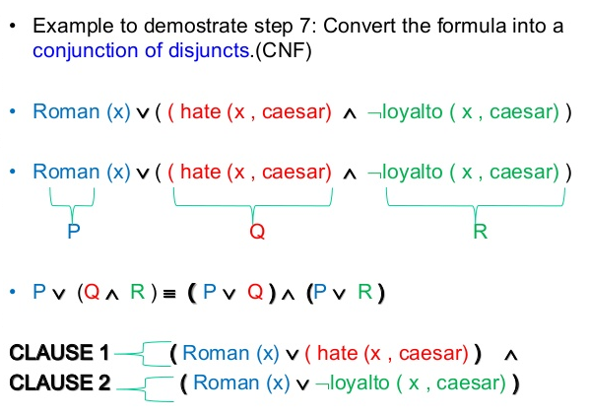

Slide 25
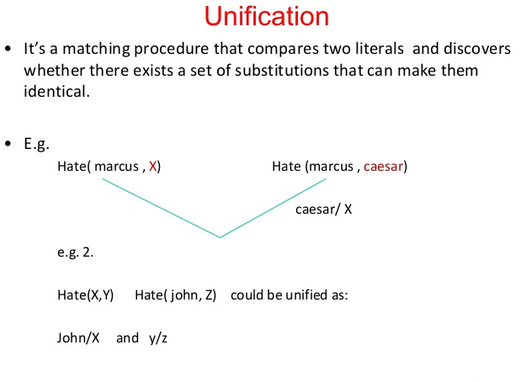

Slide 26
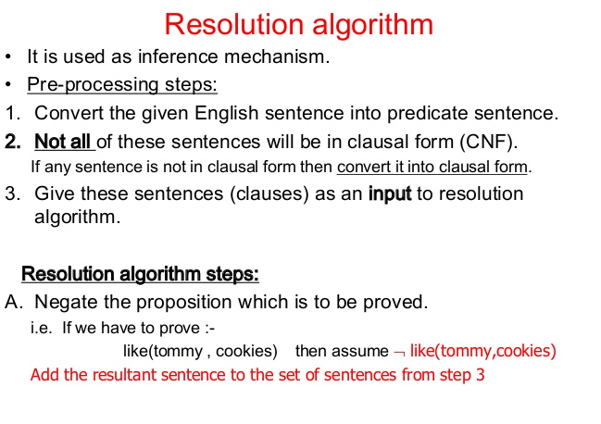

Slide 27
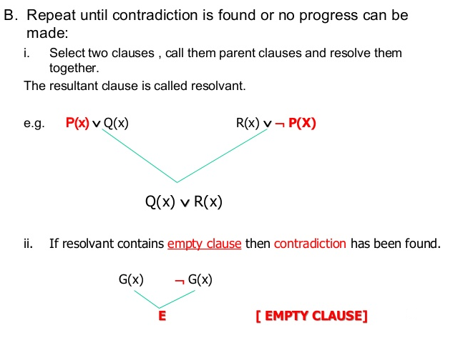
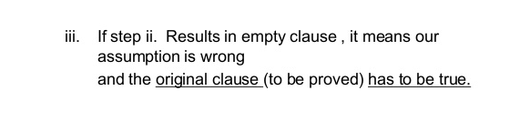

Slide 28
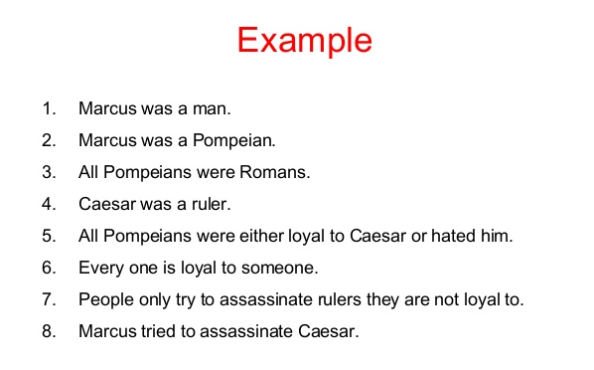

Slide 29
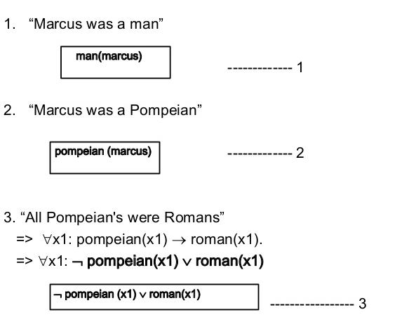
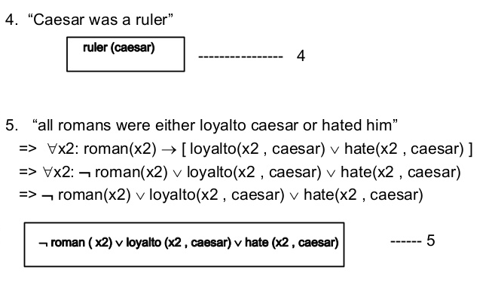

Slide 30
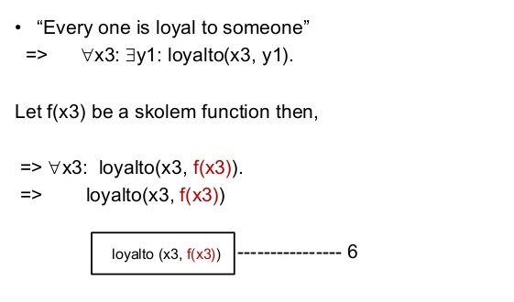
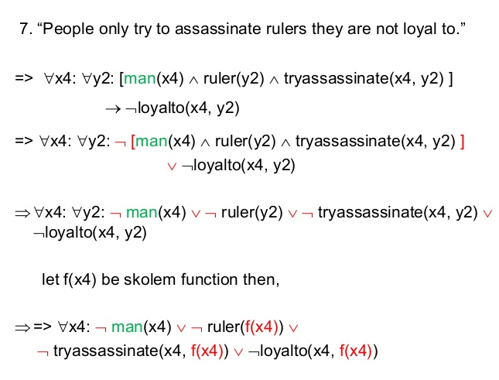

Slide 31
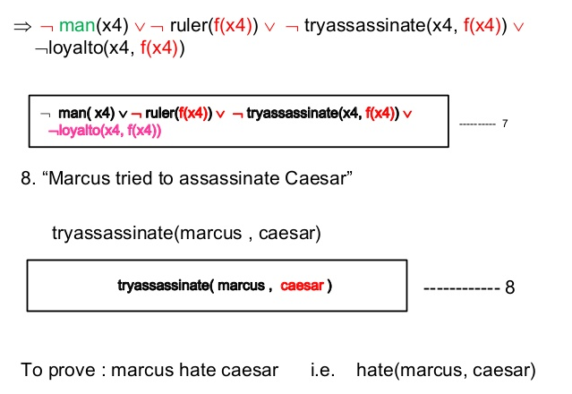

Slide 32
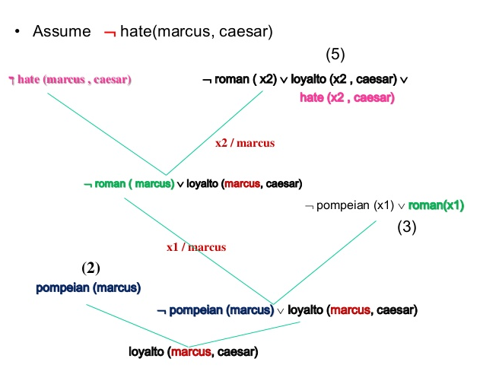

Slide 33
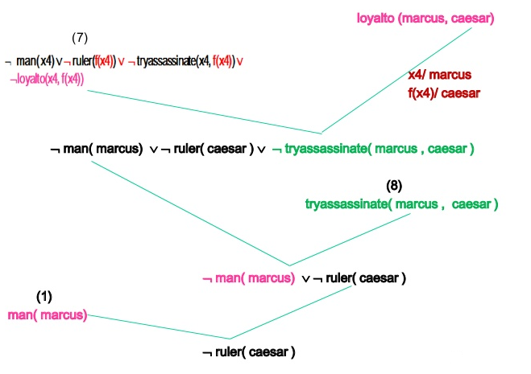

Slide 34
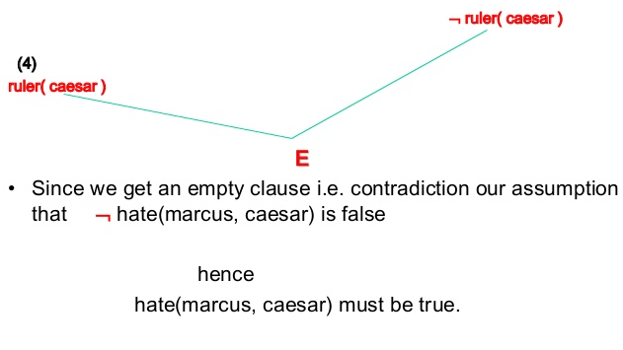

Slide 35
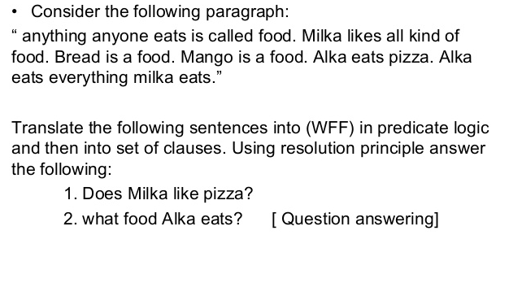

Slide 36
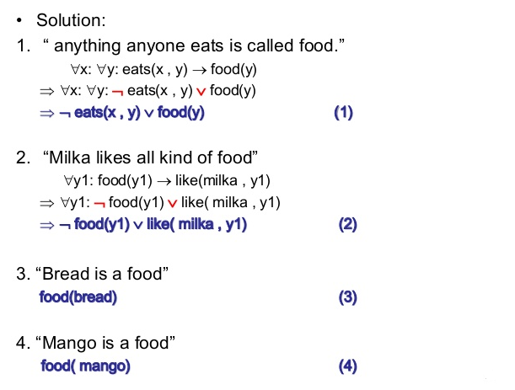

Slide 37
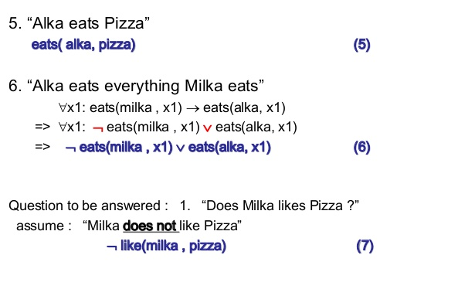

Slide 38
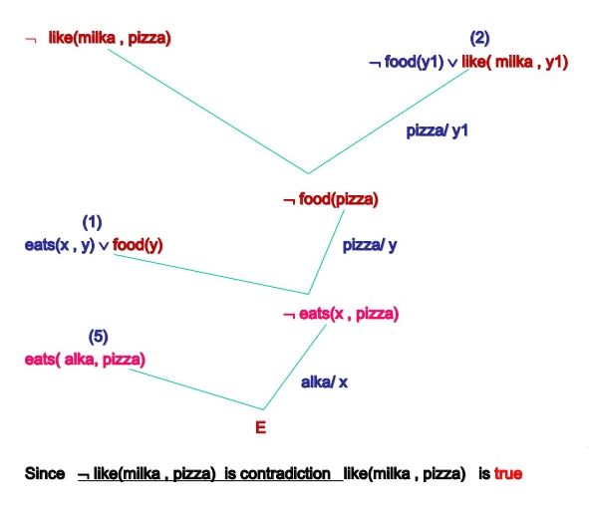

Slide 39
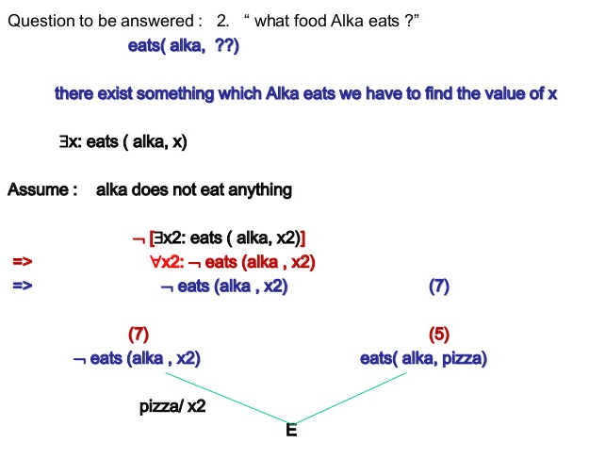

Slide 40
